Slide 1
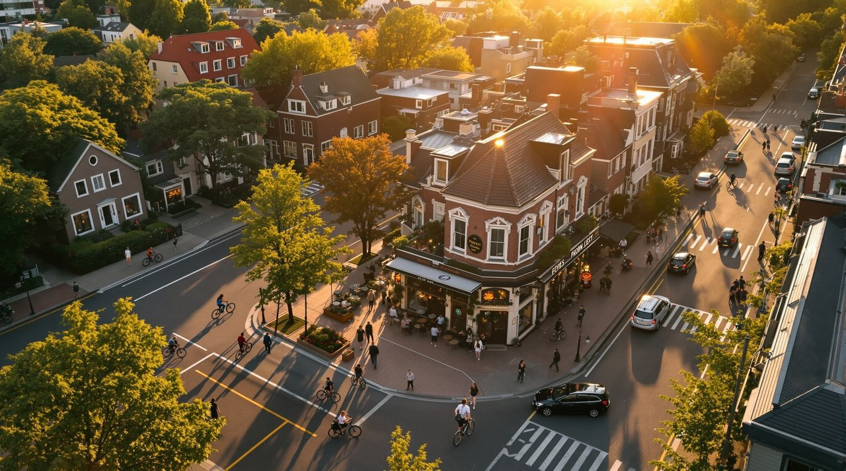
15-Minute City: Explainer
A human-scale urban model where most daily needs are reachable within a 15-minute walk or bike ride.

Slide 2
Agenda
Definition & Principles
Case Studies: Paris, Melbourne
Street Redesign Elements
Mixed-Use Zoning Toolkit
Mobility Modes
Equity & Accessibility
Misconceptions & Myth-busting
Cost/Benefit
Implementation Roadmap & Metrics
15-Minute City: Explainer

Slide 3
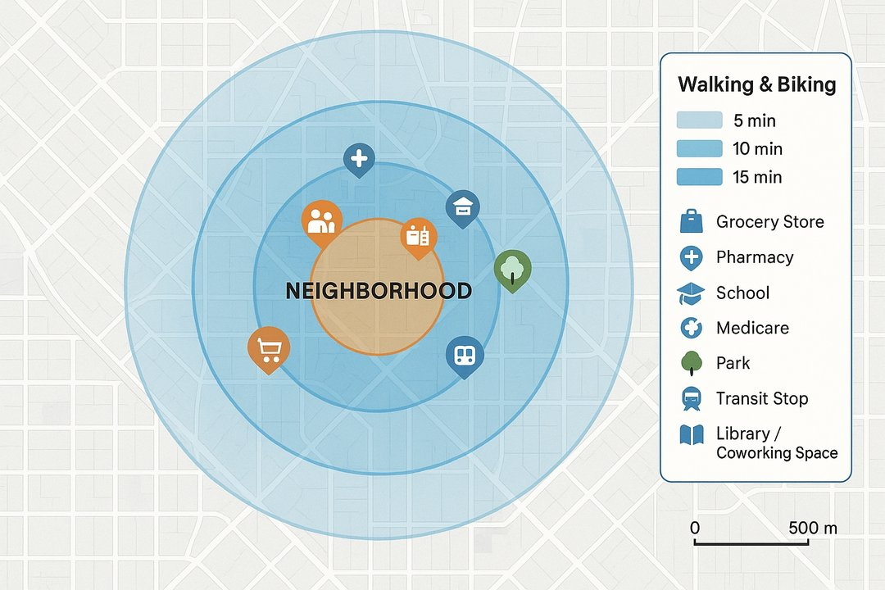
What Is a 15-Minute City?
Definition: A planning framework that clusters daily needs—home, work, learning, care, groceries, parks—within a 15-minute walk or bike ride, prioritizing proximity, safety, and choice.
Principles
Proximity: short trips to essentials
Diversity: mixed uses and housing types
Density done well: enough people to support services
Complete networks: safe, continuous walking/cycling/transit
Human-scaled streets: slower speeds, greener public realm
Digital/physical integration: delivery lockers, telehealth, coworking
Participatory governance: neighborhood co-design
Equity: invest first where access gaps are largest
Climate resilience: shade, stormwater, low-carbon mobility
Service Basket
Groceries/pharmacy
Primary school/childcare
Clinic
Pocket/linear park
Transit stop
Coworking/library
Everyday retail
15-Minute City: Explainer

Slide 4
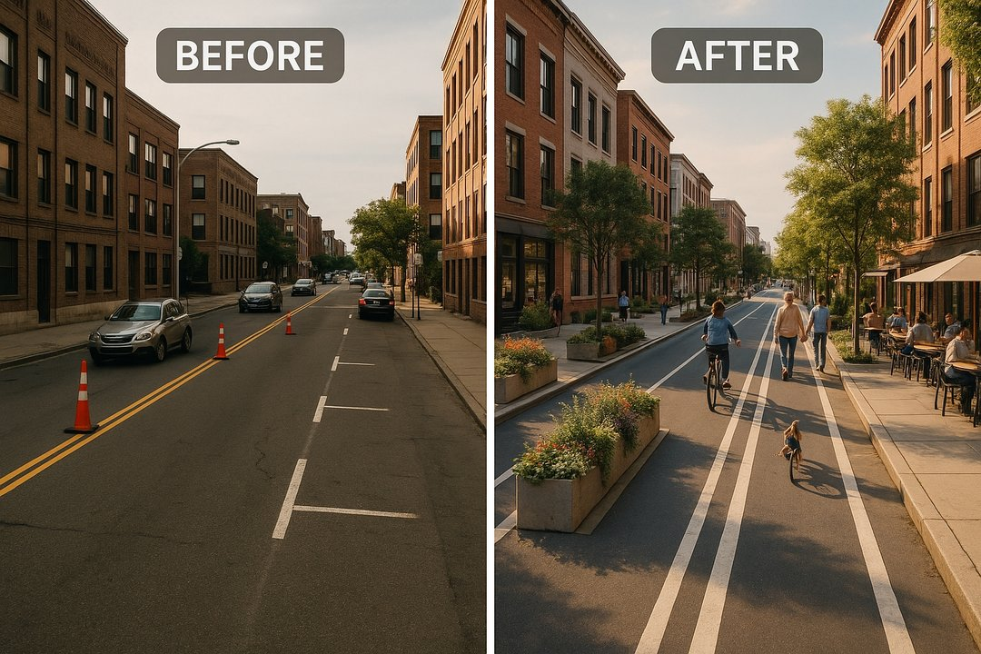
Case Studies: Paris & Melbourne
Paris
Approach
Citywide proximity strategy—school street closures, bike network expansion, local services, and 30 km/h default on most streets.
Highlights
'Rues aux écoles' (car-lite school streets)
Neighborhood-scale amenities and micro-hubs
Protected cycleways connecting arrondissements
Learning
Pair quick-build trials with permanent upgrades; communicate benefits at the block level.
Melbourne
Approach
'20-minute neighborhoods' within Plan Melbourne (walkable catchments to daily needs).
Highlights
Activity centers as anchors
Green links/laneways network
Health and aging-in-place focus
Learning
Use activity center hierarchy to stage investment; align with health outcomes.
Programs evolve; shown features are illustrative.
15-Minute City: Explainer

Slide 5
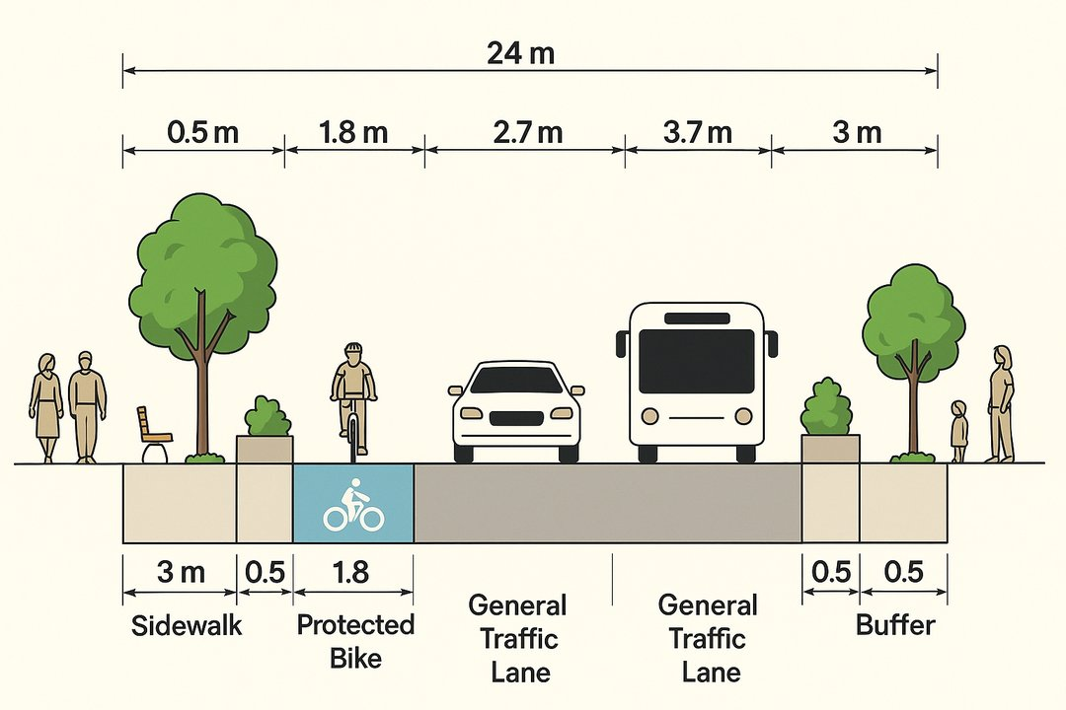
Street Redesign Elements (Complete Streets)
Continuous sidewalks with curb ramps and tactile paving
Protected bike lanes (physical separation) and intersection protection
Bus priority (dedicated lanes, queue jumps), all-door boarding
Traffic calming: 30 km/h design speeds, raised crossings, chicanes
Curb management: loading bays, micromobility parking, parklets
Green infrastructure: shade trees, bioswales, permeable surfaces
Safety at night: pedestrian-scale lighting
Typical Cross-Section (24m ROW)
Sidewalk + furnishing:
3.0 m each side
Protected bike track:
1.8 m + 0.5 m buffer each side
Bus lane:
3.0 m each direction
General traffic lane:
2.7 m each direction
Adjust widths to local standards; maintain continuous protection at intersections.
15-Minute City: Explainer

Slide 6
Mixed-Use Zoning Toolkit
Form-Based Codes
Missing-Middle Housing
Tool × Outcome Matrix
Regulate form and frontage, not just use; ensure active ground floors.
Triplexes, courtyard apts, ADUs to diversify options near services.
Walkability
Housing Supply
Local Services
Affordability
Small-Biz
Adaptive Reuse
Parking Reform
Form-Based Codes
Convert offices/big-box to housing, schools, clinics.
Eliminate minimums; use maximums/shared/cash-out; price curbs.
Missing-Middle
Adaptive Reuse
Parking Reform
Inclusionary Zoning
Corner Commercial Allowance
Reserve % of units as affordable near transit/amenities.
Inclusionary
Small-format retail/childcare/cafés embedded in residential blocks.
Corner Commercial
Policy note: Pair zoning with grants/TA for small developers and main-street businesses.
15-Minute City: Explainer

Slide 7
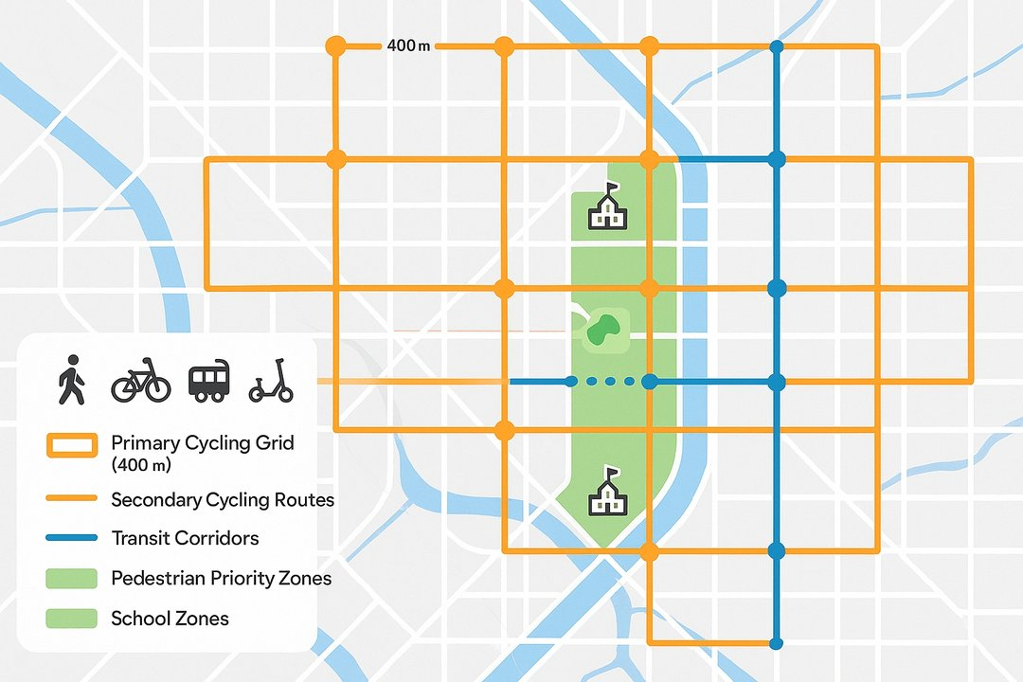
Mobility Modes & Networks
Mobility Modes
🚶
Walking: universal baseline; continuous shade and crossings
🚲
Cycling/e-bikes: protected network; secure parking at shops/schools
🚌
Transit: frequent local buses/trams; timed transfers; integrated fares
🛴
Micromobility: shared scooters/bikes with designated corrals
📦
Deliveries: cargo bikes and off-peak loading to reduce conflicts
🚗
Car share: right-sized auto access without ownership
Mode Share Targets
Walk: 14% → 20%
Bike: 5% → 12%
Transit: 18% → 25%
Car: 63% → 43%
Network map with layered mobility infrastructure: primary cycling grid (400m spacing), secondary cycling links, transit corridors with frequency-based stops, and pedestrian priority zones
Shift enabled by complete networks and pricing reform
15-Minute City: Explainer

Slide 8
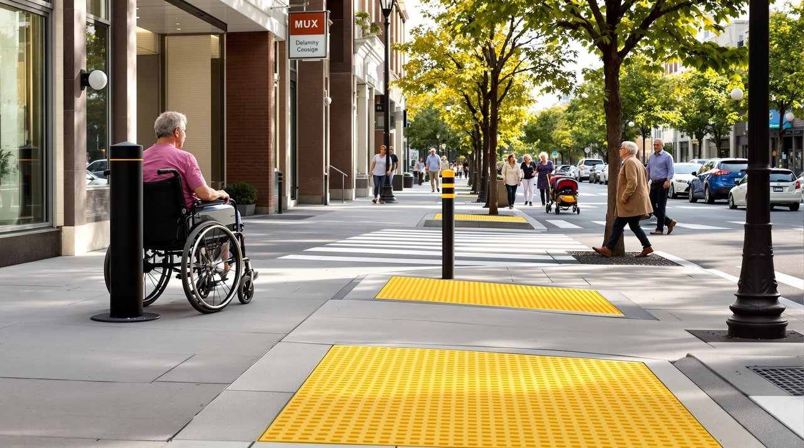
Equity & Accessibility
Equity Levers
Invest first in underserved neighborhoods (access deserts)
Zero-fare/transit discounts for low-income riders and youth
Anti-displacement: community land trusts, right-to-return, rent stabilization tools
Safe routes to school and late-night worker corridors
Community co-design: multilingual workshops, stipends, childcare
Universal Design
Continuous curb ramps and tactile guidance at crossings
Audible signals, seating every 100–150 m; shade and lighting
Step-free building entries; wider doorways; at-grade transit boarding
Key Performance Indicators
% low-income residents within 15-min of groceries/clinic
Crash rate per 100k (ped/bike)
Transit travel time to jobs (p50/p90)
15-Minute City: Explainer

Slide 9

Misconceptions & Myth-Busting
Myth:
Fact:
15-minute cities 'restrict movement.'
They expand choices by bringing more nearby; regional and intercity travel remains.
Myth:
Fact:
It's anti-car.
It's pro-option; safer walking/biking/transit plus smarter car use.
Myth:
Fact:
Only works in dense European cores.
Applicable with context—retrofit arterials, re-center town centers, and add mixed uses.
Myth:
Fact:
Hurts business.
Foot traffic and dwell time typically increase on people-first streets.
Myth:
Fact:
Too expensive.
Low-cost pilots and curb pricing fund phased, high-return upgrades.
Myth:
Fact:
One-size-fits-all.
Co-designed with neighborhoods; services reflect local needs.
15-Minute City: Explainer

Slide 10
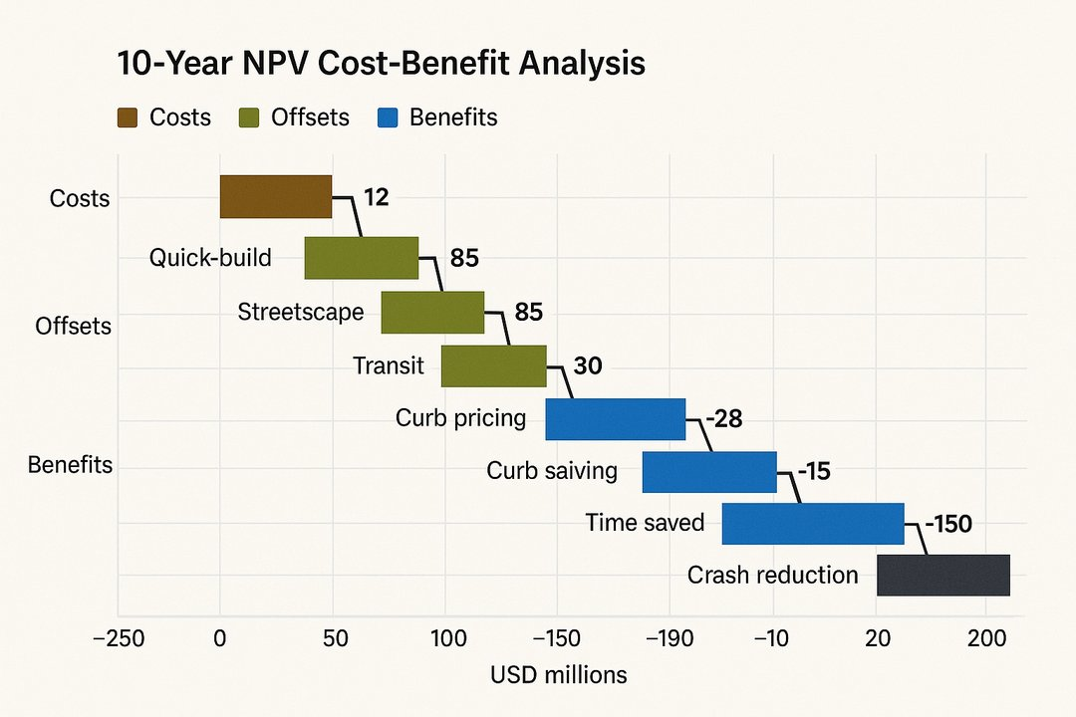
Costs and Benefits (Illustrative, per 100k residents, 10-yr NPV @3%)
Costs
Quick-build pilots (paint/posts/planters)
+$12M
Permanent streetscape + bikeways
+$85M
Transit priority upgrades
+$30M
Public realm/trees/stormwater
+$18M
Ops/maint. (net of savings)
+$22M
Offsets & Revenue
Curb pricing/parking reform
-$28M
Speeding/crash cost reductions (city savings)
-$15M
Benefits
Travel time saved (mode shift/shorter trips)
-$190M
Health (active mobility; reduced PM2.5)
-$120M
Crash reduction (ped/bike/veh)
-$150M
Retail uplift/local spending retention
-$60M
Costs
Offsets
Benefits
Net
GHG reduction (social cost of carbon)
-$25M
Monetization methods per standard CBA (e.g., USDOT guidance); tailor to local context.
15-Minute City: Explainer

Slide 11
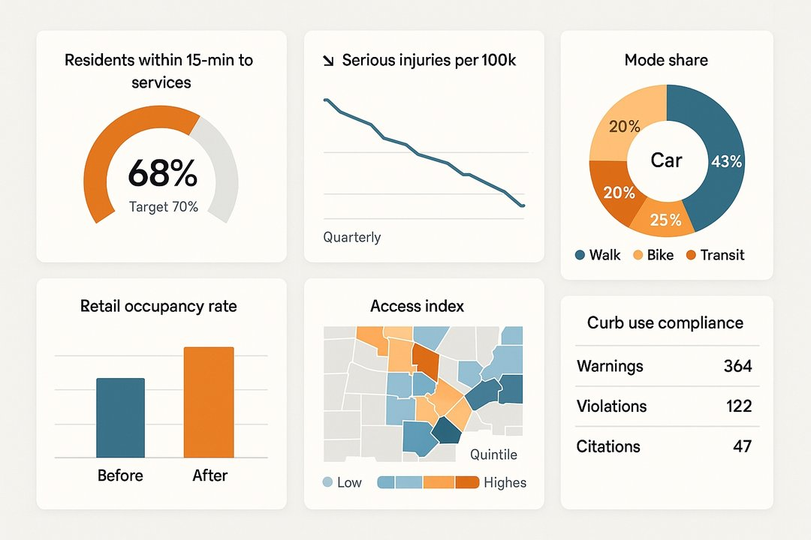
Implementation Roadmap & Metrics Dashboard
0–6 months
Choose 2–3 pilot neighborhoods via equity criteria
Quick-build: school streets, pop-up bikeways, curb management zones
Launch co-design workshops; publish access baseline and targets
6–18 months
Make successful pilots permanent; shade trees and drainage added
Zoning updates: missing-middle, corner retail, parking reform
Transit: signal priority, bus lanes on key corridors
18–36 months
Scale to additional districts; integrate health and economic KPIs
Institutionalize curb pricing; fund maintenance and main-street grants
Annual report with isochrone maps and crash/health outcomes
Streets & Safety
Land Use & Housing
Transit & Operations
Equity & Community
Data & Evaluation
15-Minute City: Explainer

